Slide 1
Tokyo 2020 Olympics
Medal Analysis
What factors are associated with Olympic medal success?
HBO ICT Business Analytics · Semester 3 · Dataset: Tokyo 2020 Olympics (Kaggle) · 93 countries · 11,085 athletes
Notes:
Welcome. This presentation analyses the Tokyo 2020 Olympic dataset to find statistical associations between how countries participate and how many medals they win. Two research questions, two regression models, and a clear business takeaway.

Slide 2
The Dataset
11,085
93
46
Athletes
Countries
Disciplines
individual competitors
from 206 countries
that won at least
one medal
unique sports
at Tokyo 2020
How the analysis dataset was built:
① Aggregate Athletes file
② Join with Medals file
③ Final dataset
One row per athlete → grouped by country to count total athletes (AthleteCount) and unique disciplines (DisciplineCount) per country.
Medal totals per country joined on country name (NOC). Result: 93 rows, one per medal-winning country.
3 key variables ready for regression: Total Medals (Y), AthleteCount (X₁), DisciplineCount (X₂).
Notes:
Before we run any models we need to understand the data. The Athletes file has 11,085 rows — one per athlete. We aggregated it to 93 country-level rows and joined it with the medal table.

Slide 3
Research Questions
Is there a linear relationship between how many athletes a country sends and how many medals it wins?
Q1
X (independent): AthleteCount — total athletes sent (numeric) | Y (dependent): Total Medals won (numeric)
Is there a linear relationship between how many disciplines a country competes in and how many medals it wins?
Q2
X (independent): DisciplineCount — unique sports entered (numeric) | Y (dependent): Total Medals won (numeric)
Both models use Ordinary Least Squares (OLS) Simple Linear Regression · Both X and Y variables are numeric · 93 observations
Notes:
Two research questions, both using simple linear regression. Key point: for linear regression, the primary X variable must be numeric. AthleteCount and DisciplineCount are both numeric counts — this satisfies the assumption.

Slide 4
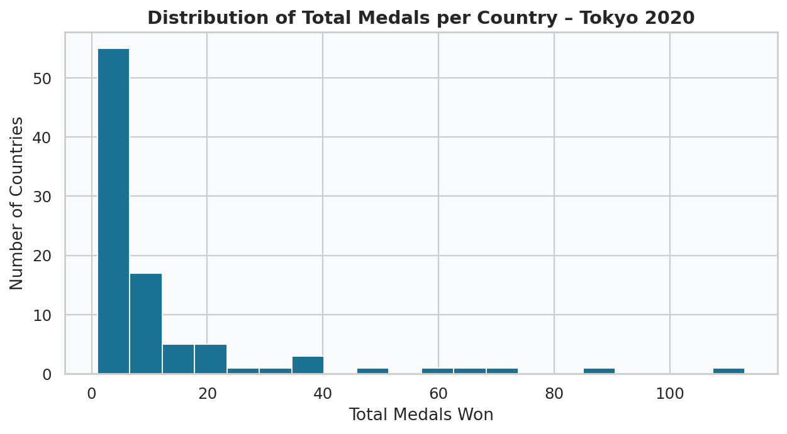
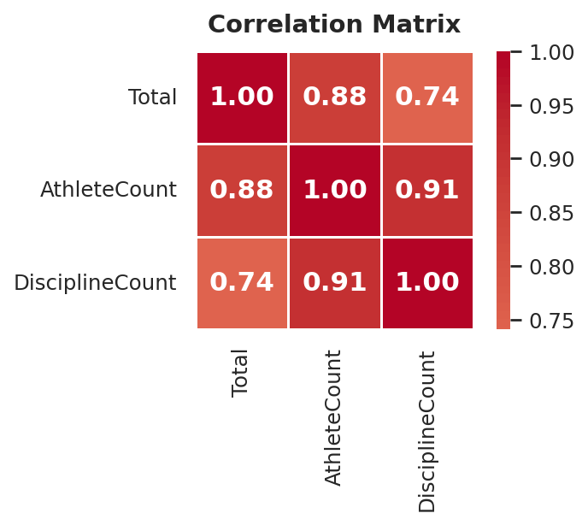
Exploring the Data
What does this tell us? The distribution is strongly right-skewed — most countries win fewer than 10 medals. A small number of powerful nations dominate. This is the reality of Olympic competition.
So what? AthleteCount correlates with Total at r = 0.88, DisciplineCount at r = 0.74. Both are strong — both are worth modelling.
Notes:
Before modelling, always explore the data. Two key observations: 1) medal counts are skewed — keep outliers in, they are real. 2) The correlation matrix shows both predictors are strongly related to medal count, which justifies both models.

Slide 5
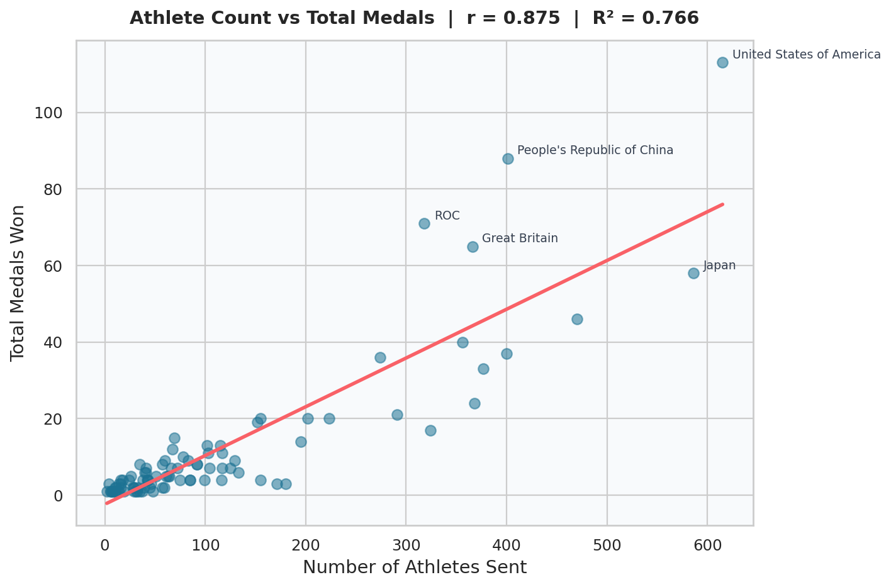
Q1 — Athlete Count & Medal Success
r = 0.875
Pearson correlation coefficient
Very strong positive association
R² = 0.766
76.6% of medal variation
explained by athlete count alone
β = +0.127
Each additional athlete sent is
associated with +0.13 more medals
p < 0.001
Statistically significant — this
association is not due to chance
So what? Countries that send larger delegations are strongly associated with winning more medals. Sending 8 more athletes relates to roughly 1 extra medal on average. This is the strongest finding in our analysis.
Notes:
Walk through each statistic. r = 0.875 means very strong positive correlation. R² = 0.766 means athlete count explains 76.6% of the variation — that is very high for a single-variable model. The coefficient β = 0.127 tells us the slope: each extra athlete is associated with 0.127 more medals. p < 0.001 means this result is statistically significant.

Slide 6
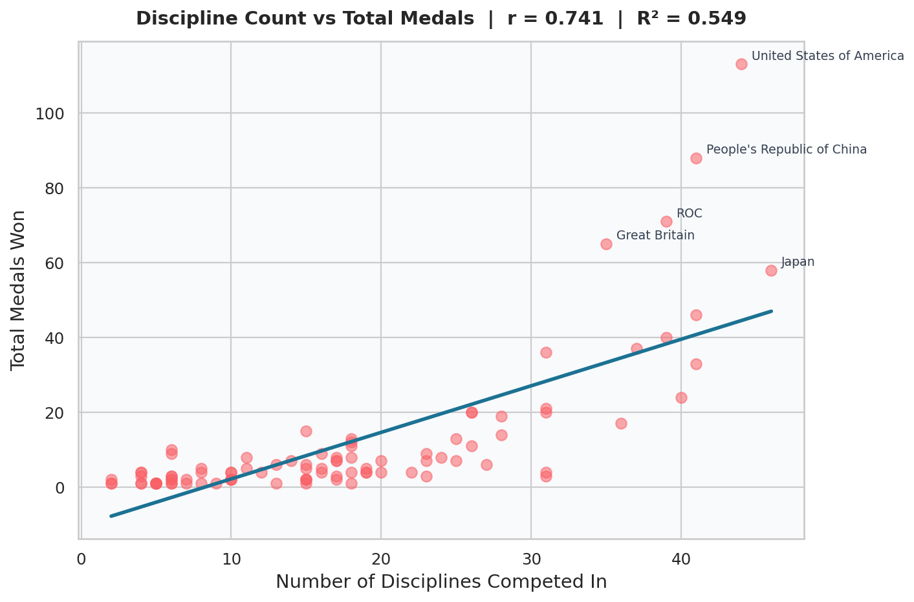
Q2 — Discipline Breadth & Medal Success
r = 0.741
Pearson correlation coefficient
Strong positive association
R² = 0.549
54.9% of medal variation
explained by discipline count
β = +1.244
Each extra discipline entered is
associated with +1.24 more medals
p < 0.001
Statistically significant — this
association is not due to chance
So what? Countries competing across more sports also tend to win more medals — but this relationship is weaker than athlete count (R² drops from 0.766 to 0.549). Breadth matters, but size matters more.
Notes:
Same structure as the previous slide. r = 0.741 is still strong, but noticeably weaker than 0.875. R² = 0.549 — discipline count explains just over half the variation. Important nuance: athlete count and discipline count are related — bigger squads naturally compete in more sports. Model 2 may partly be picking up the same signal as Model 1.

Slide 7
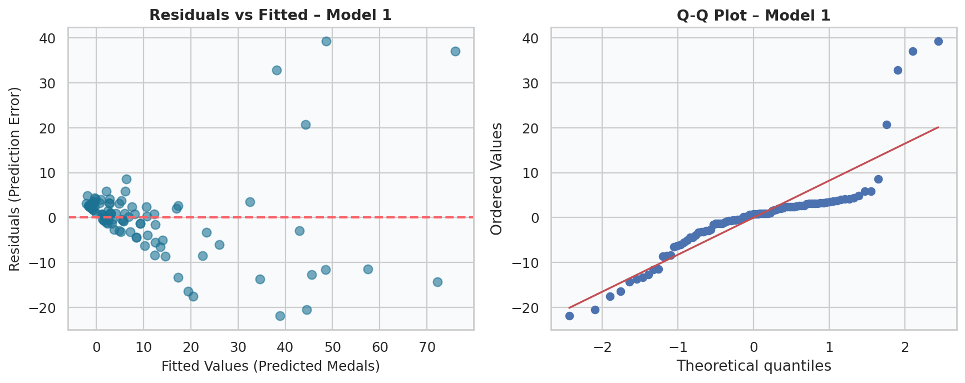
Understanding Residuals
A residual is the difference between what the model predicted and what actually happened.
If our model says a country should win 20 medals but they won 35 — the residual is +15.
Residuals vs Fitted: Points scattered around the red line at zero = the model's errors are random, not systematic. There is a slight fan shape at higher values, which indicates heteroscedasticity.
Q-Q Plot: Points follow the diagonal line in the middle but deviate at the tails — residuals are not perfectly normal, driven by outlier nations (USA, China) at the top end.
Notes:
Many students skip residuals — this shows you actually understand the methodology. Explain what a residual is in plain language first. Then explain what the two plots tell you. The violations are real but expected given the outlier nations.

Slide 8
Regression Assumptions
Linear regression requires 5 assumptions. Checking them shows whether the model results can be trusted.
Assumption | What it means | Model 1 | Model 2
Linearity | X and Y have a straight-line relationship | ✅ Satisfied | ✅ Satisfied
Independence | Each observation (country) is separate and unrelated | ✅ Satisfied | ✅ Satisfied
Normality of residuals | Prediction errors follow a normal distribution (Shapiro-Wilk test) | ⚠️ Violated — outliers skew the tails | ⚠️ Violated — outliers skew the tails
Homoscedasticity | Residuals have constant variance (Breusch-Pagan test) | ⚠️ Violated — variance fans out | ⚠️ Violated — variance fans out
No multicollinearity | Only one X variable — not applicable | N/A | N/A
What does this mean for our findings? The violations are caused by outlier nations — the USA, China, and ROC are extreme cases that inflate residual variance and skew the distribution. These are real data points, not errors. Despite the violations, both models have very strong R² values and p-values far below 0.001. The overall associations we found are robust — but results should be interpreted as associations, not predictions.
Notes:
Be transparent about the violations — this demonstrates methodological maturity. The key message: the violations do not invalidate the findings, they are a known limitation driven by the outlier nations. The strong R² and p-values still give us confidence in the associations.

Slide 9
Comparing the Two Models
① Both are significant
p < 0.001 in both models. Neither result is due to chance.
② Model 1 is stronger
r = 0.875, R² = 0.766. Squad size is the dominant factor.
③ Model 2 also holds
r = 0.741, R² = 0.549. Discipline breadth matters — but less so.
④ The two are correlated
Bigger squads enter more sports. Model 2 partly echoes Model 1.
Business insight: For national Olympic committees, the data suggests that investing in a larger athlete pool is more strongly associated with medal success than spreading across many sports. Depth before breadth.
Notes:
This is the payoff slide. Compare r and R² side by side for both models. Then connect to a real business insight: if you are advising a national Olympic committee, what does this data tell them about strategy?

Slide 10
Conclusions & Limitations
Conclusions
Limitations
Q1 — Yes: Strong positive association between athlete count and medals. r = 0.875, R² = 0.766, p < 0.001.
Q2 — Yes: Positive association between discipline count and medals. r = 0.741, R² = 0.549, p < 0.001.
Key finding: Athlete count is the stronger predictor. How many athletes you send matters more than how many different sports you enter.
Both associations are statistically significant and robust.
Correlation ≠ Causation
Wealthier countries invest more in sport AND send more athletes. A third variable drives both.
Assumption violations
Normality and homoscedasticity violated due to dominant nations. Results are directionally correct but confidence intervals should be treated with caution.
Missing context
GDP, population, sports budget, and historical performance are not included — these would improve the model significantly.
Notes:
End on honesty. The limitations do not undermine the findings — they contextualise them. The most important limitation is correlation vs causation: we are identifying associations, not proving that sending more athletes causes more medals.

